Slide 1
Teacher LM: A Generalized Reasoning Model
Chenyang Zhao
Junior in Computer Science and Technology (CST)
Tsinghua University, Beijing, China
https://www.cs.tsinghua.edu.cn/csen/

Slide 2
Intution
Following the release of the GPT-3 model, researchers have demonstrated that In-Context Learning with fixed parameters can unlock the reasoning capability of large-scale language models. However, small-scale language models have difficulty using prompts to perform complex reasoning tasks with fixed parameters.
CoT Instruction Finetuning with reasonings has also been shown to improve the reasoning ability of large-scale language models by relaxing the condition to allow parameter updates but requires a large amount of data with finetuning processes to improve the reasoning ability of small-scale models. Even so, the models still perform poorly after using CoT Instruction Finetuning to improve their inference; even CoT Instruction Finetuning is often less effective than simply using Instruction Finetune without adding CoT.
Therefore, we would like to propose a new language model, the Teacher LM, dedicated to generating reasoning processes that provide model-generated high-quality reasoning for existing QA tasks, replacing manually annotated CoT. Ultimately, our reasoning is used to perform CoT Instruction Finetune, improving small-scale language models’ reasoning ability.

Slide 3
Contribution
We proposed and open-sourced the first set of general-purpose inference language models dedicated to reasoning generation, i.e. the Teacher LM.
We demonstrate that Finetune can unlock complex reasoning capabilities for small-scale language models on a small amount of data with model-generated CoT.
Finally, we propose a new paradigm for training-friendly unlocking of inference power of language models based on Teacher-Student Learning and knowledge distillation.

Slide 4
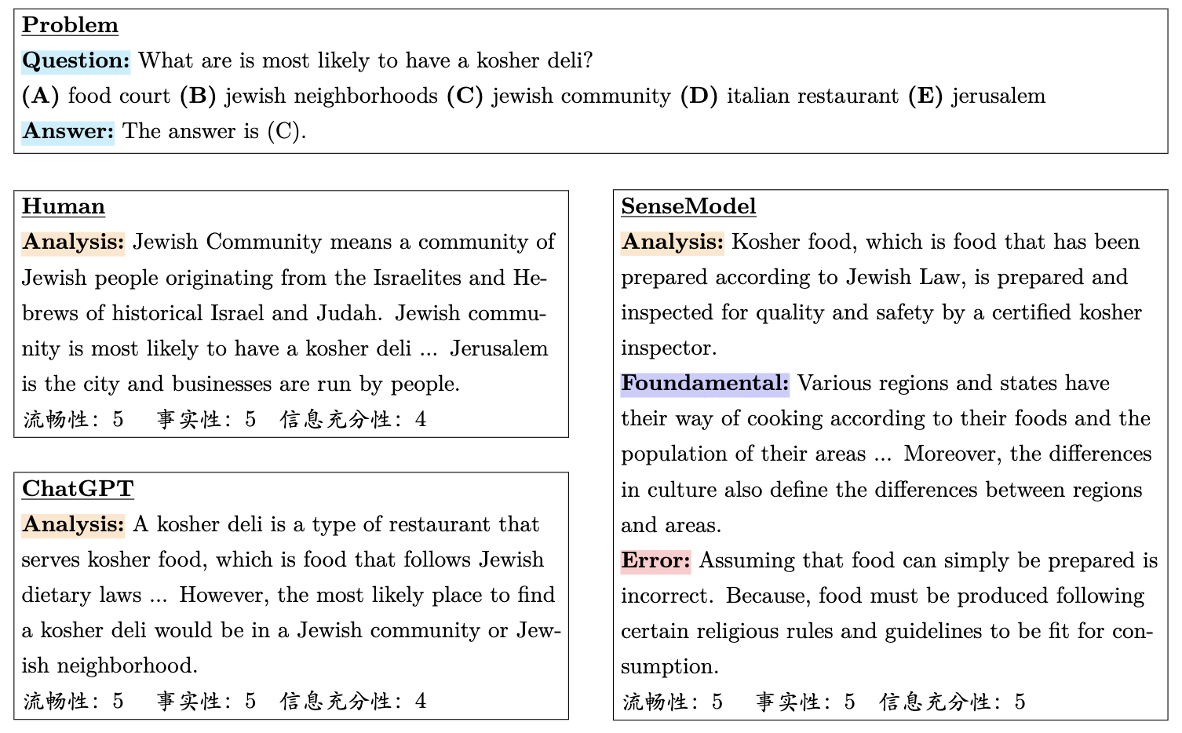
Human Evaluation
On the left is the manually annotated reasoning and the ChatGPT-generated reasoning, while on the right is the Teacher LM-generated reasoning.

Slide 5
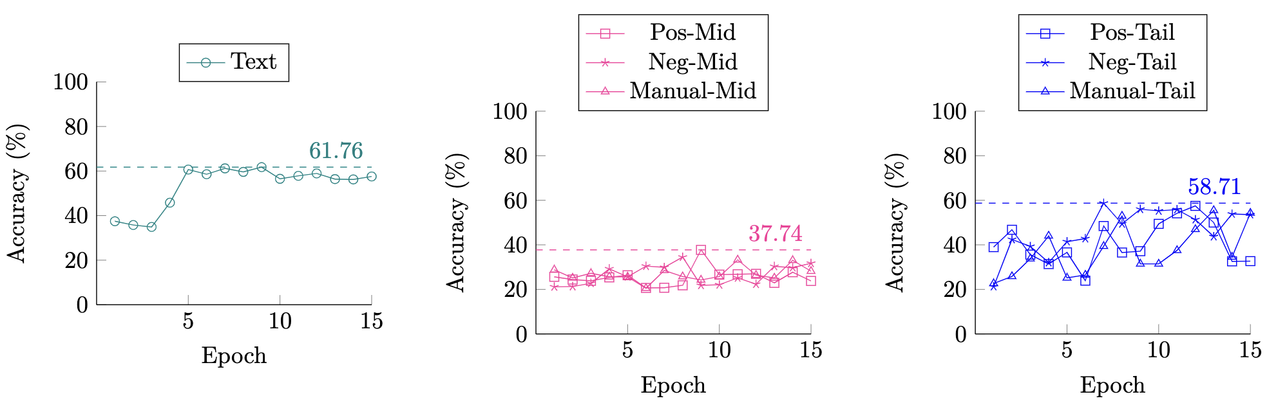
Finetune Results
Take the example of ECQA, a multiple-choice question dataset of moderate difficulty.
Each sample has six fields: question, answer, five options, correct answer resolution (pos), incorrect answer resolution (neg), and overall resolution (manual), for which Teacher LM generates three fields: model CoT (cot), common errors (error), and related knowledge (fundamental).
In our plot, the Text means only question + answer for Finetune; Manual-Mid means question + manual + answer; Manual-Tail means question + answer + manual, and so on.

Slide 6
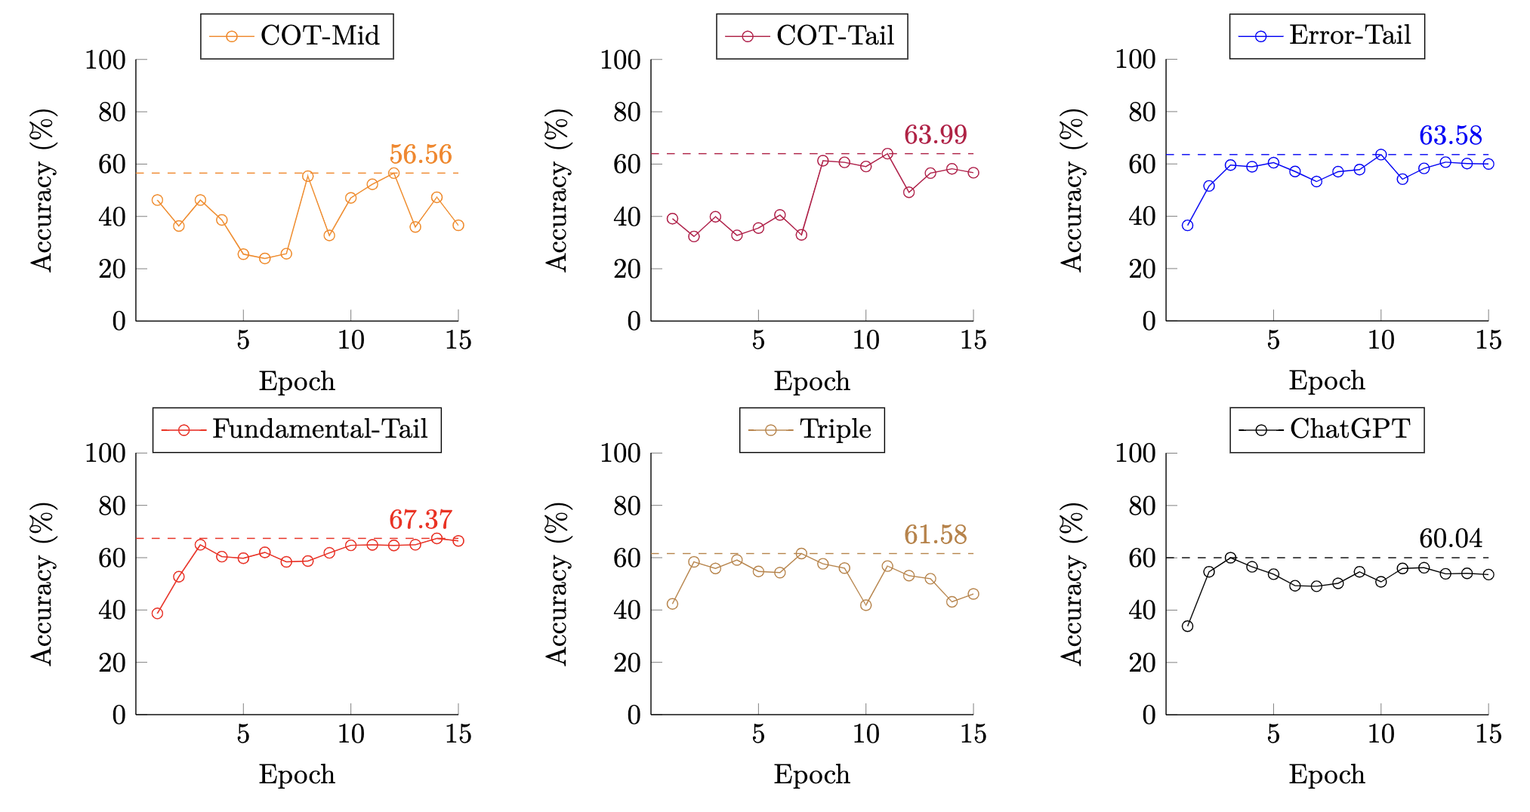
Finetune Results
CoT-Tail means input question + answer + cot; Triple means that Error-Tail, CoT-Tail and Fundamental-Tail are directly overlapped and trained together; ChatGPT means the reasoning of CoT-Tail is replaced with that of ChatGPT.

Slide 7
Discussion
Manual reasoning and 7B1 Teacher LM's reasoning are comparable in the human evaluation, but after Finetune of the small-scale model, Teacher LM's CoT is significantly better than manual reasoning.
Tail-Training is less effective than Middle-Training combined with Self-Consistency. The model's performance could be further improved if the latter were used.
Common Sense Task (ECQA, for example) does not reflect reasoning ability as properly as Math Word Problems (GSM8K) because the former relies on reasoning ability and the model's objective memory of relevant common sense.
Lastly, CoT hurts are still common, probably due to the dual effect of the model's small size and the poor amount of data.

Slide 8
Thanks
Chenyang Zhao
Junior in Computer Science and Technology (CST)
Tsinghua University, Beijing, China
https://www.cs.tsinghua.edu.cn/csen/

